Slide 1
CSE 420
Intermediate Code Generation
Lecture 12-13

Slide 2
Compiler Architecture
Intermediate Code
Parser
Static Checker
Intermediate Code generator
Code Generator
Target language
Front End
Back End
m × n compliers can be built by writing m front ends and n back ends – save considerable amount of effort
We assume parsing, static checking and IC generation is done sequentially
  These can be combined and done during parsing
Static checking
  Operator operand compatibility
  Proper placement of break/continue keywords etc.

Slide 3
Intermediate Code (IC)
The given program in a source language is converted to an equivalent program in an intermediate language by the IC generator.
Ties the front and back ends together
Language and Machine neutral
Many forms
Level depends on how being processed
More than one intermediate language may be used by a compiler

Slide 4
Intermediate language can be many different languages, and the designer of the compiler decides this intermediate language.
Intermediate Code (IC)
syntax trees can be used as an intermediate language.
postfix notation can be used as an intermediate language.
three-address code (Quadraples) can be used as an intermediate language
  quadraples are close to machine instructions, but they are not actual machine instructions.
some programming languages have well defined intermediate languages.
  java
  prolog
  byte-code emulators

Slide 5
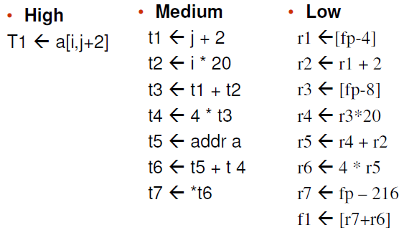
Intermediate language levels

Slide 6
Intermediate Languages Types
Graphical IRs:
  Abstract Syntax trees
  Directed Acyclic Graphs (DAGs)
  Control Flow Graphs
Linear IRs:
  Stack based (postfix)
  Three address code (quadruples)

Slide 7
Graphical IRs
Abstract Syntax Trees (AST) – retain essential structure of the parse tree, eliminating unneeded nodes.
Directed Acyclic Graphs (DAG) – compacted AST to avoid duplication – smaller footprint as well
Control flow graphs (CFG) – explicitly model control flow

Slide 8
a := b *-c + b*-c
ASTs and DAGs:
:=
:=
a
+
a
+
*
b - (uni)
*
*
- (uni)
b - (uni)
b
c
c
c
AST
DAG

Slide 9
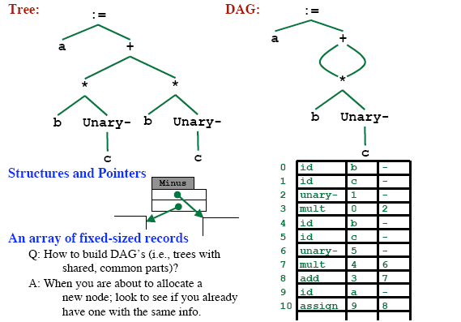
Implementation of DAG/AST: Value Number Method

Slide 10
Three-Address Code
A three-address code is:
x := y op z
where x, y and z are names, constants or compiler-generated temporaries; op is any operator.
But we may also the following notation for three-address code (it looks like a machine code instruction)
op y,z,x
apply operator op to y and z, and store the result in x.
We use the term “three-address code” because each statement usually contains three addresses (two for operands, one for the result).

Slide 11
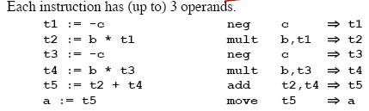
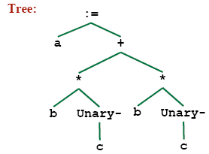
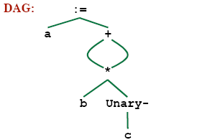
Linearized Representation of DAG/AST
Source Code
– a = b * -c + b * -c
Three address code
Tree Representation

Slide 12
Three-Address Statements
Binary Operator: op y,z,result or
result := y op z
where op is a binary arithmetic or logical operator. This binary operator is applied to y and z, and the result of the operation is stored in result.
Ex:
add a,b,c
gt a,b,c addr a,b,c
addi a,b,c
Unary Operator: op y,,result or
result := op y
where op is a unary arithmetic or logical operator. This unary operator is applied to y, and the result of the operation is stored in result.
Ex: uminus a,,c

Slide 13
Three-Address Code
Two concepts
  Address
  Instruction
Address
  Name: source-program names to appear as addresses
  Constant: Different types of constants
  Compiler Generated temporary:

Slide 14
Three-Address Instruction
Assignment Type 1: x := y op z
op is a binary arithmetic or logical operation
x, y and z are addresses
Assignment Type 2: x := op z
op is a unary arithmetic or logical operation
x and z are addresses
Copy Instruction: x := y
x and z are addresses and x is assigned the value of y

Slide 15
Three-Address Instructions
Unconditional Jump: goto L
We will jump to the three-address code with the label L, and the execution continues from that statement.
Ex: goto L1 jmp 7
Conditional Jump 1: if
// jump to L1
// jump to the statement 7
x goto L and if False
x goto L
We will jump to the three-address code with the label L if x is TRUE
and FALSE, respectively. Otherwise, the following three-address instruction in sequence is executed next.
Conditional Jump 2: if x relop y goto L
We will jump to the three-address code with the label L if the result of y relop z is true, and the execution continues from that statement. If the result is false, the execution continues from the statement following this conditional jump statement.

Slide 16
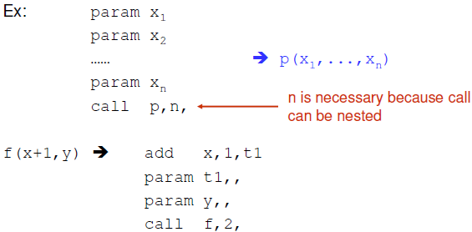
Three-Address Statements (cont.)
Procedure Parameters: param x
Procedure Calls: call p,n
where x is an actual parameter, we invoke the procedure p with
n parameters.

Slide 17
Three-Address Statements (cont.)
Indexed Assignments:
x := y[i]
sets x to the value in location i memory units beyond location y
y[i] := x
sets contents of the location i memory units beyond location y to the value of x
Address and Pointer Assignments:
x := &y
sets the r-value of x to l-value of y
x := *y
where y is a pointer whose r-value is a location
sets the r-value of x equal to the contents of that location
*x := y
sets the r-value of the object pointed by x to the r-value of y

Slide 18
Three address code example
do i=i+1; while (a[i] < v)
L: t₁=i+1 | 100: | t₁ = i +1
i=t₁ | 101: | i = t₁
t₂=i*8 | 102: | t₂=i*8
t₃=a[t₂] | 103: | t₃=a[t2]
if t₃ < v goto L | 104: | if t₃ < v goto 100
(A) Symbolic Labels | (B) Position Numbers

Slide 19

Representing 3-Address Statements
op, arg1, arg2, result
x = minus y
  Does not use arg2
x = y
  Op is =
param a1
  Uses neither arg2 nor result
Conditional/Unconditional jumps
– Put the target label in result

Slide 20
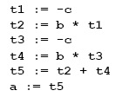
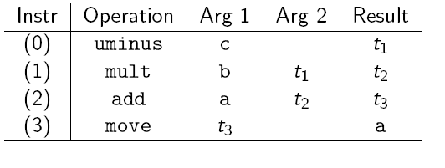
Quadruples
• a = b * -c + b * -c

Slide 21
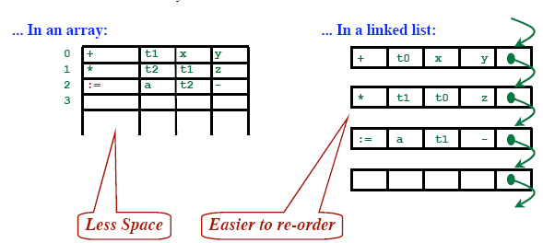
Quadruples
Store each fields directly

Slide 22
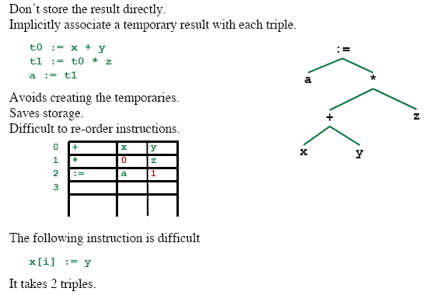
Triples
op | arg1 | arg2
[ ]= | x | i
:= | 0 | y
0
1

Slide 23
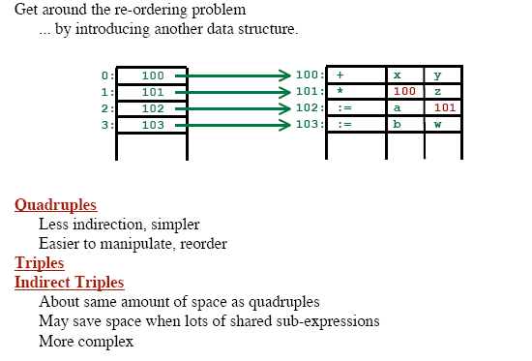
Indirect Triples

Slide 24
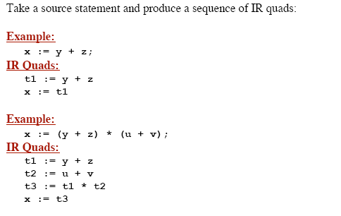
Goal

Slide 25
Addressing Array Elements
Elements of arrays can be accessed quickly if the elements are stored in a block of consecutive locations.
A one-dimensional array A:
 | … |  | …
base_{A} low
i
width
base_{A} is the address of the first location of the array A,
width is the width of each array element. low is the index of the first array element

Slide 26
Addressing Array Elements (cont.)
base_{A}+(i-low)*width
can be re-written as i*width
+ (base_{A}-low*width)
should be computed at run-time
can be computed at compile-time
So, the location of A[i] can be computed at the run-time by evaluating the formula i*width+c where c is (base_{A}-low*width) which is evaluated at compile-time.
Intermediate code generator should produce the code to evaluate this formula i*width+c (one multiplication and one addition operation).

Slide 27
Two-Dimensional Arrays
A two-dimensional array can be stored in
  either row-major (row-by-row) or
  column-major (column-by-column).
Most of the programming languages use row-major method.
Row-major representation of a two-dimensional array:
row₁
row₂
row_{n}

Slide 28
Two-Dimensional Arrays (cont.)
The location of A[i₁,i₂] is
base_{A}+ ((i₁-low₁)*n₂+i₂-low₂)*width
base_{A} is the location of the array A.
low₁ low₂
is the index of the first row
is the index of the first column
n₂ is the number of elements in each row
width is the width of each array element
Again, this formula can be re-written as ((i₁*n₂)+i₂)*width + (base_{A}-((low₁*n₁)+low₂)*width)
should be computed at run-time
can be computed at compile-time

Slide 29
Multi-Dimensional Arrays
In general, the location of A[i₁,i₂,...,i_{k}] is
(( ... ((i₁*n₂)+i₂) ...)*n_{k}+i_{k})*width + (base_{A}-((...((low₁*n₁)+low₂)...)*n_{k}+low_{k})*width)
So, the intermediate code generator should produce the codes to evaluate the following formula (to find the location of A[i₁,i₂,...,i_{k}]) :
(( ... ((i₁*n₂)+i₂) ...)*n_{k}+i_{k})*width + c
To evaluate the (( ... ((i₁*n₂)+i₂) ...)*n_{k}+i_{k} portion of this formula, we can use the recurrence equation:
e₁ = i₁
e_{m} = e_{m-1} * n_{m} + i_{m}

Slide 30
Translation of Array Elements
One dimensional
base + i × w
w: width of each array element
Two Dimensional
base + i₁ × w₁ + i₂ × w₂
w₁: width of a row
w₂: width of an element in a row
k dimensional (generalized)
base + i₁ × w₁ + i₂ × w₂ + … + i_{k} × w_{k}

Slide 31
Control Flow
Translation of conditional statements is tied to translation of Boolean expressions.
Boolean expressions are used to
  Alter the flow of control, e.g. if (E) S
  Compute logical values
Evaluated in analogy to arithmetic expressions
Intended use of Boolean expression is determined from its syntactic context
  Expression follows the keyword if
    Alter the flow of control
  Expression on the right side of an assignment
    Denote a logical value

Slide 32
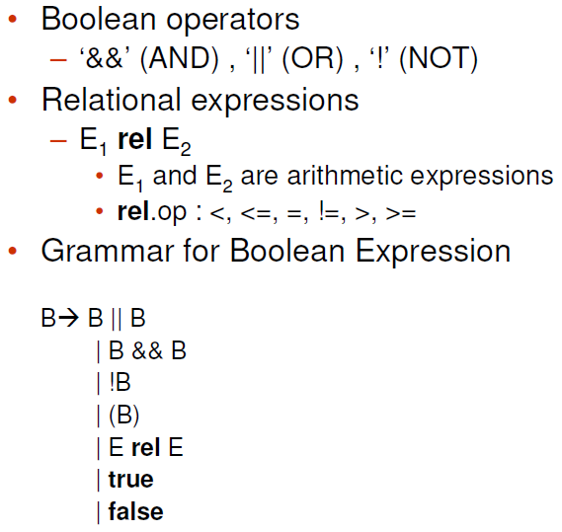
Boolean Expression

Slide 33
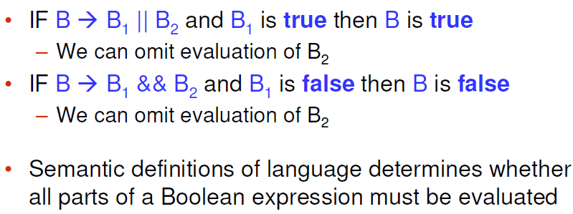
Short-Circuit Code

Slide 34
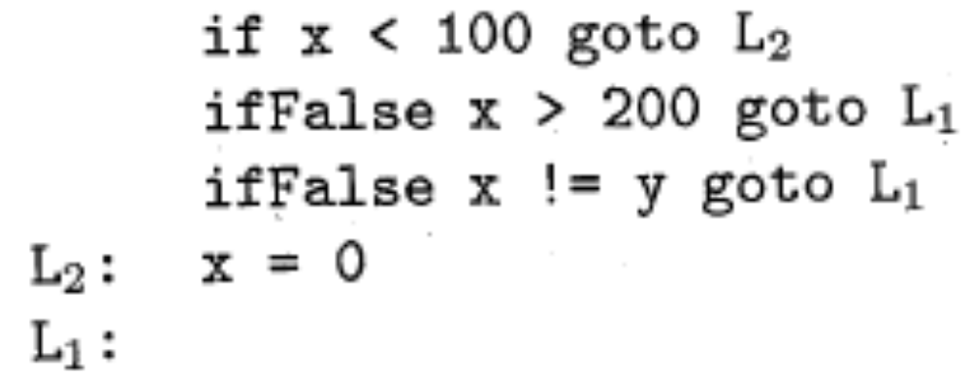
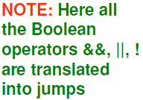
Short-Circuit Code

Slide 35
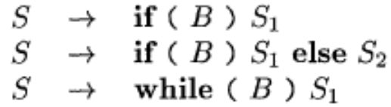

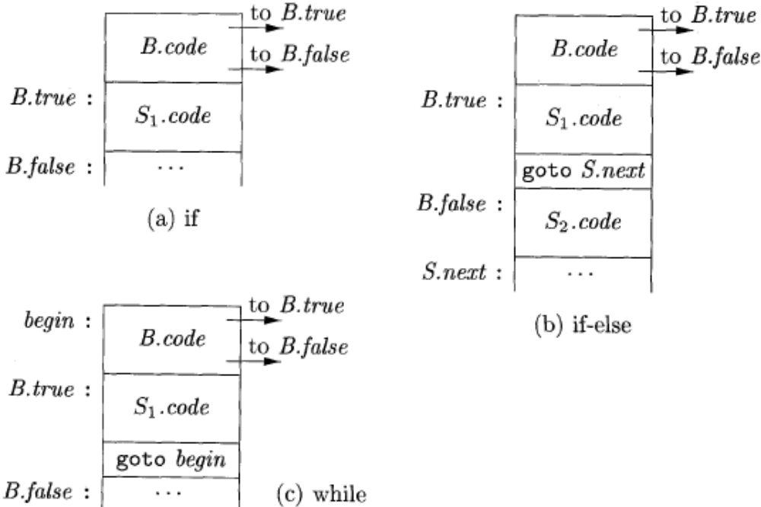
Flow-of-Control Statements

Slide 36
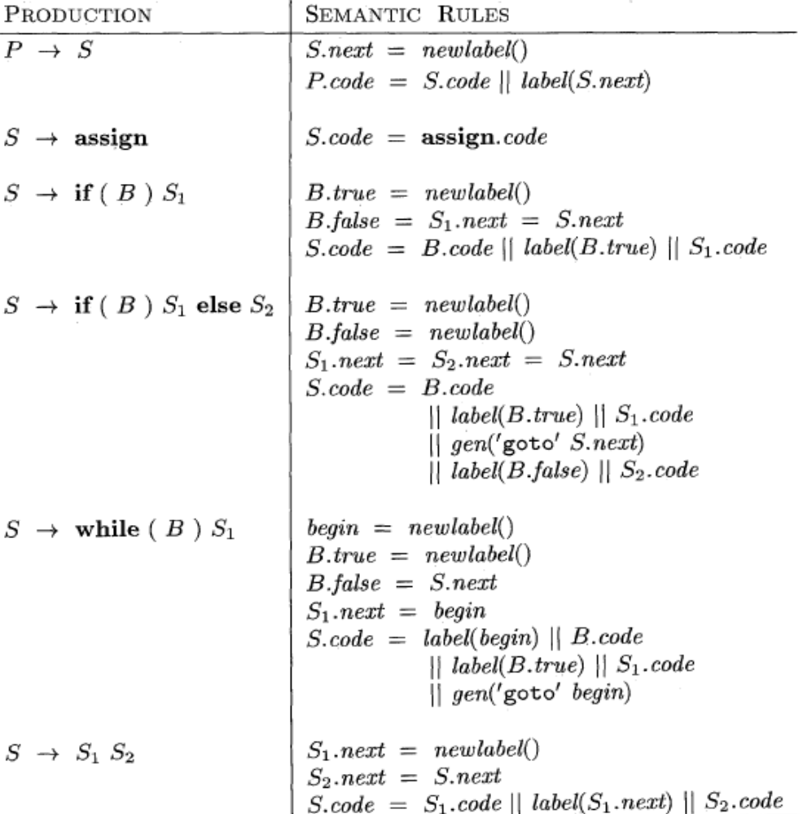
Syntax directed definition for flow-of-control statements

Slide 37
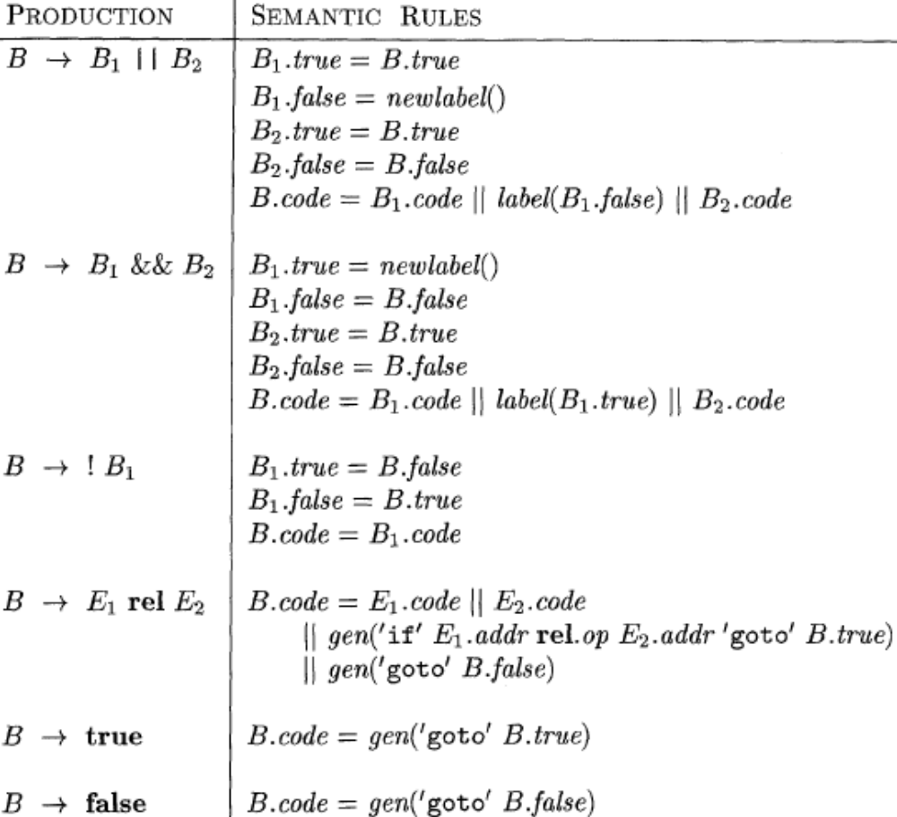
Generating three-address code for booleans

Slide 38
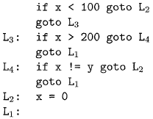
Example

Slide 39
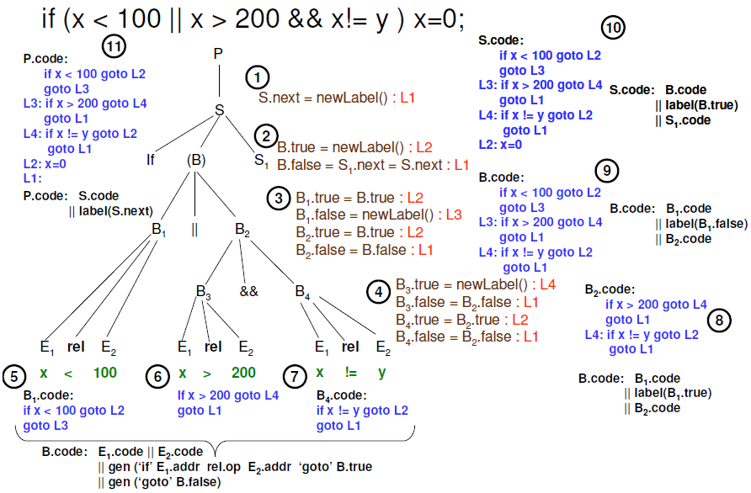
Example

Slide 40
Backpatching
Easiest way to implement the translations is to use two passes
In one pass we may not know the target label for a jump statement
Backpatching allows one pass code generation
Generate branching statements with the targets of the jumps temporarily unspecified
Put each of these statements into a list which is then filled in when the proper label is determined

Slide 41
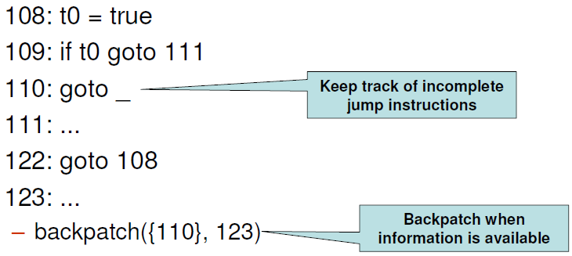
Backpatching

Slide 42
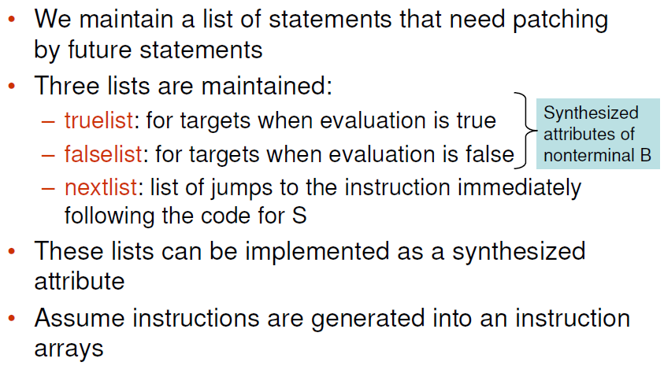
Backpatching

Slide 43
Back-patching
For non-terminal B we use two attributes B.truelist and B.falselist together with following functions:
  makelist(i): create a new list containing only i, an index into the array of instructions
  Merge(p1,p2): concatenates the lists pointed by p1 and p2 and returns a pointer to the concatenated list
  Backpatch(p,i): inserts i as the target label for each of the instruction on the list pointed to by p

Slide 44
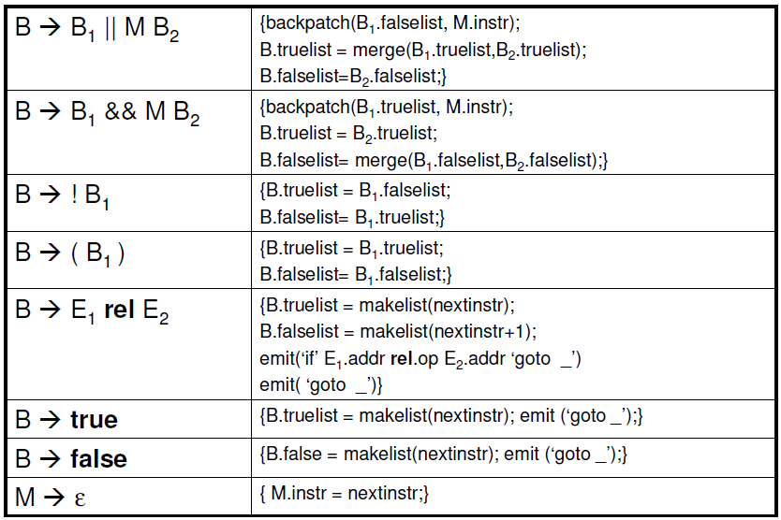
Backpatching for Boolean Expressions

Slide 45
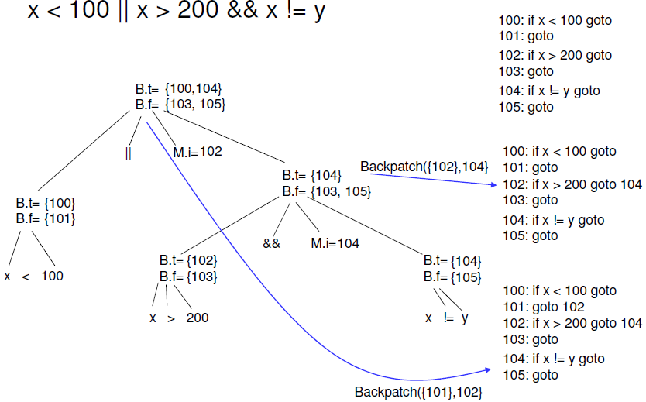
Backpatching for Boolean Expressions
Annotated parse tree for x < 100 || x > 200 && x ! = y

Slide 46
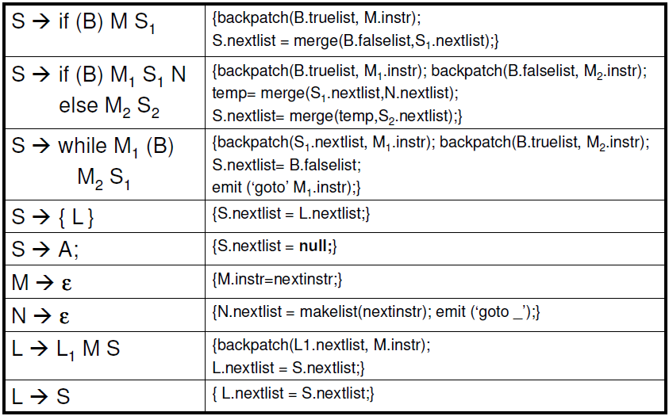
Back-patching for flow of control statements

Slide 47
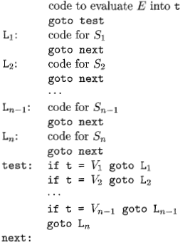
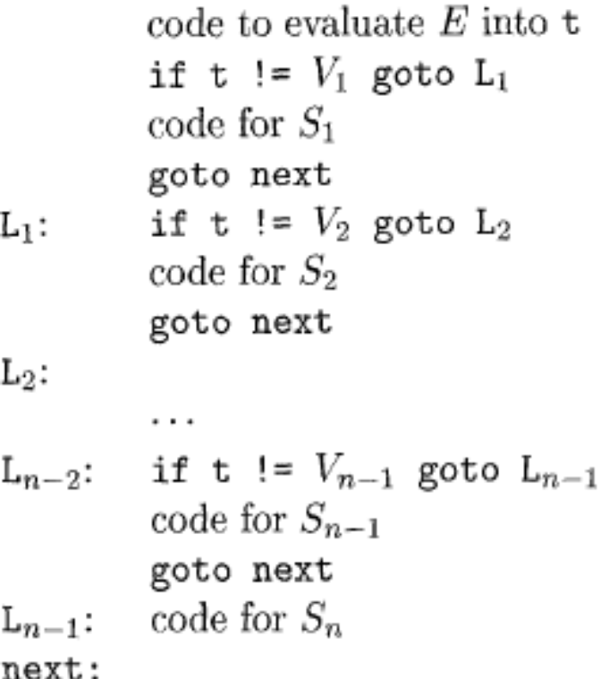
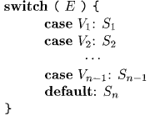
Translation of a switch-statement

Slide 48


Back-patching Practice
if(m>2 && m<50 && m%3==0){
a=a+2;
b++;
m/=3
}
else{
a=a+5;
b--;
}

Slide 49
Any Question?

